Slide 1
2020-21 Graduate Trainee and Internship Program
2020-21年管理生培训生与实习生计划
Positions: Engineering
and Supporting Functions
职位：工程类与支持类
Durations 项目培训期
GT - 2 years
管理培训生 – 2年
Internship – 6 months
实习项目 – 6个月
Location: Beijing (EDF China headquarter) and project cities including Sanmenxia/ Lingbao/Wuhan/Sanya/Jinan/Songyuan, etc.
工作地点：法国电力集团中国总部位于北京，管理培训生将在中国区北京办公室与项目所在地开展工作。
项目所在地包括三门峡/灵宝/武汉/三亚/济南/松原等
About the program / 项目介绍
The Graduate Trainee Program is a fast-track program whose aim is to recruit high-potential talents majoring in Engineering or Business / Management / humanities and to turn them into future leaders able to take up critical positions within the organization.
管理培训生项目是一项针对毕业生的人才快速晋升计划，旨在招聘具有潜力的工程专业人才、商业与管理研究和/或人文专业人才，并将其培养成为担任公司内关键岗位的领导者。
The associated 6-month internship program is designed to source and identify competitive candidates among current students for the management trainee program. Students and recent graduates will work closely with our project analysts in EDF China energy services project development and management.
针对在校生，我们同时设计了为期六个月的实习生计划。实习生与管理培训生将与项目分析们一起深入参与到法电中国能源服务领域的项目开发与运行中。

Slide 2
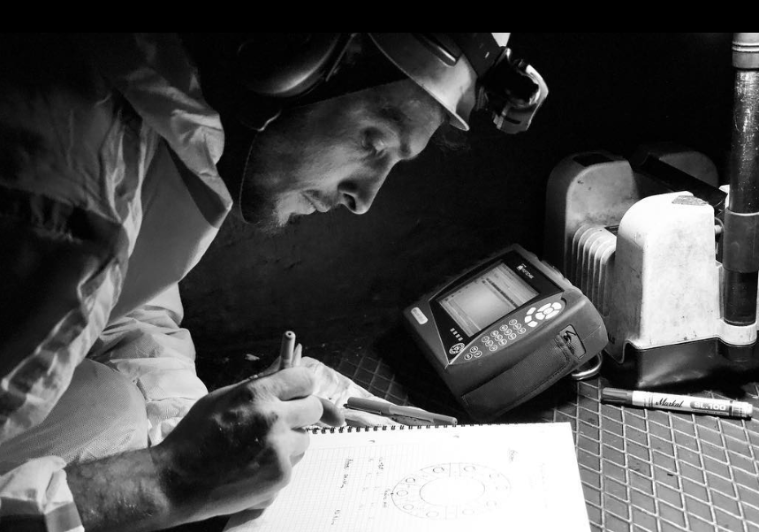
The program features / 项目特点
During the programs, the Graduate Trainees will receive substantial and intensive training, acquire job-related skills and knowledge through rotations in different projects managed by the Energy Service and New Business Unit in China (Sanmenxia, Lingbao, Wuhan, Sanya and Jinan etc.) and across various functions
在为期两年的项目中，培训生将接受系统化和高强度的培训，并通过在EDF中国能源事业部项目间（三门峡，灵宝，武汉，三亚、济南等）的岗位轮换获得跨专业的工作技能与知识培训，通过管理的不同项目轮换获得与工作相关的技能和知识。
Job rotation with substantial training / 岗位轮换与大量高价值培训
For existing projects / 现有项目
[Engineering Functions] Project operation & maintenance, operation performance optimization via energy management tool, QEHS management, technical design, etc.
[技术类] 项目运营和维护，通过能源管理工具优化运营表现，质量、环境、健康、安全管理，技术设计等
[Supporting Functions] Accounting & Finance, Marketing Development, Procurement, HR, Admin, and IT or Legal if any related background
[支持类] 财务与金融，市场开发，采购，人力资源，行政，IT，法务等
For project development/ 项目开发
[Engineering Functions]
Project due diligence, feasibility study, technical & design proposal, investment & business plan based on simulation result, etc.
[技术类] 项目尽职调查，可行性研究，技术和设计方案，基于模拟结果制定投资和商业计划等。
[Supporting Functions] Market Research, Business Communications, M&A, investor relations and Project Financing, etc.
[支持类] 市场调研, 商务沟通与谈判，收并购，项目融资等
For graduate trainee internship program, the participants will receive training and mentorship both at Beijing and from at least one of the local projects.
管理培训实习生项目的参与者将通过在北京与至少一个法电中国项目地的工作任务完成六个月的实习培训。
Project portfolio / 项目类型
District heating 区域供热
District cooling 区域制冷
Biomass power 生物质
Industrial utilities 工业能源服务
Storage and BEV 储能与电动出行

Slide 3
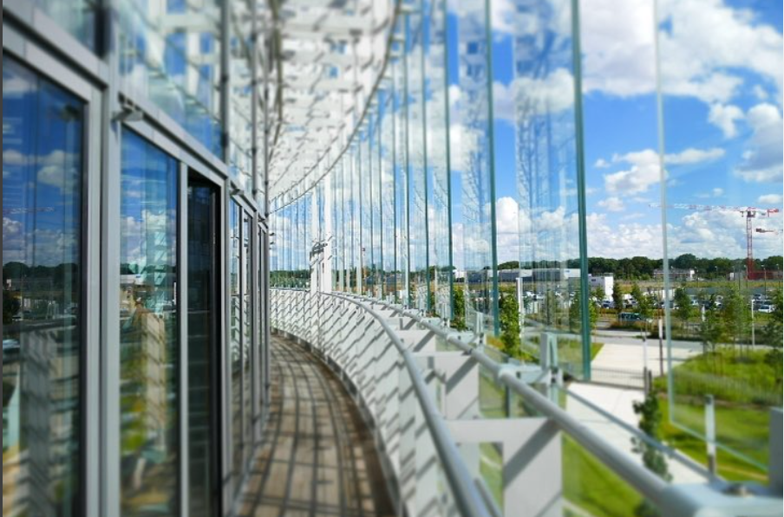
The program features / 项目特点
Exposure to key business and Regional and Global Cooperation /
接触关键业务和区域/全球合作项目
Mentorship and Career Development Support /
导师指导
Both participants in the Graduate Trainee and Internship program will be essential parts in all ESBU projects across China and have the opportunities to interact with other EDF’s subsidiaries/Business Unit both in China and globally.
培训生与实习生将参与到法电中国能源事业部的所有项目中，并有机会与其他中国或全球的子公司/业务部门进行互动。
Both trainee and internship program appoints experienced mentors providing structured guidance and support along the program to facilitate the development of the Trainees and interns.
该项目安排经验丰富的指导者，提供结构化的指导与支持，以促进培训生与实习生的发展。
Ideal candidate profile / 理想的候选人要求
GT Program 管理培训生
0-2 years working experience
0-2年工作经验
GT Internship 管理培训实习生
Enrolled in master or higher-level programs 硕士或以上学位在读
Full time internship
全职实习
Master Degree (or higher) in Engineering, Business, Accounting, Finance, Management Studies, Humanities, etc. from a reputable university
知名大学硕士及以上学位, 工程类、商务、财务、金融、管理、人文社科等专业
Proficient in both English and Chinese, French would be a plus
精通中英双语，会法语者更佳
Great team player with strong leadership potential
优秀的团队协作者，具有领导者潜力
Strong analytical thinking and problem-solving oriented
分析型思考者，乐于解决问题
Willing to travel
乐于出差
Motivated, development-minded, and up for a challenge
有内在发展动力，具有发展意识，乐于迎接挑战
To apply please email your CV and a covering letter highlighting why you suit the role to:
manfei.he@edf.fr . (+86 10 5651 1402)

